Slide 1
CAR ACCIDENT SEVERITY
Ajeesh Sunny

Slide 2
Introduction
Data Understanding
Methodology
Result and Evaluation
Discussion
Conclusion
INDEX

Slide 3
INTRODUCTION
This project mainly aims to predict how severity of accidents can be reduced based on a some factors.
The target audience of this project is car drivers, police, government authorities.
The result of this project help to advice the audience about the possibility of getting into a car accident and how severe it would be, based on the different conditions such as weather, light, road.It would help them to drive carefully.

Slide 4
DATA ENGINEERING
The data was collected by the Seattle police department.
It contain details of car accidents which have taken place within the city of Seattle.
The time period of the data is from 2004 to present.
The data consists of 37 attributes or variables and it includes information such as severity, location, collision type,Weather conditions, road condition and light conditions.

Slide 5
2.1 Data Cleaning
After reviewing all 37 attribute columns in the datasets, I have to drop the non-relevant columns.
Y was given value of 1 whereas N and nan value was given 0 for the attributes like speeding ,under the influence.
Also, most of the features are of type object, when they should be numerical type.
All the categorical variables are converted to numerical data using one-hot encoding.
The time format is changed to default standard.

Slide 6
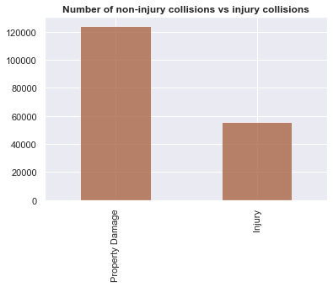
3. Methodology
3.1Exploratory Analysis
In total number of accidents in Seattle most of them are property damaged only collision are more than injured.

Slide 7
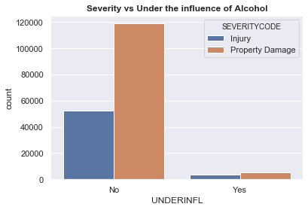
Accidents due drivers under influence.

Slide 8
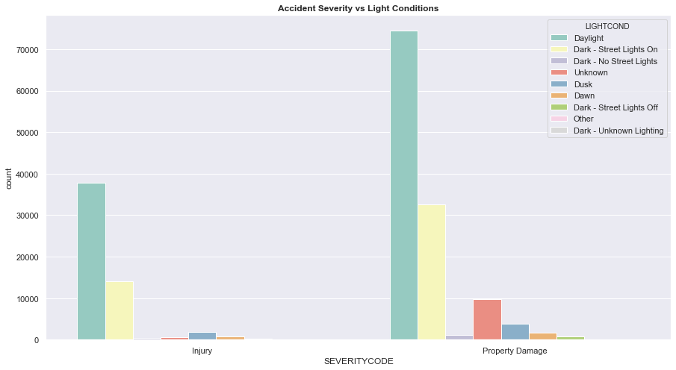
Relationship between Lighting condition and severity of accident:

Slide 9
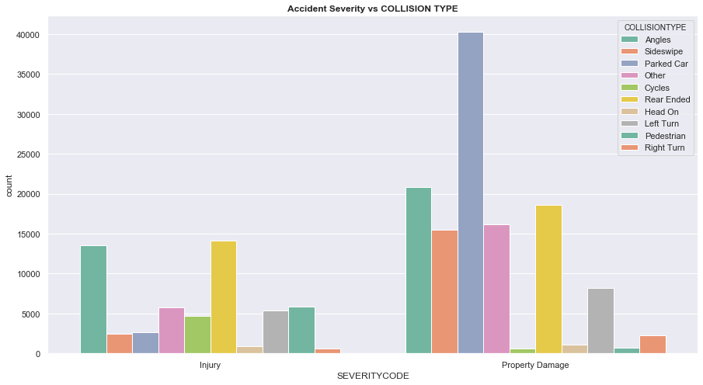
Relationship between Collision type and severity of accident:

Slide 10
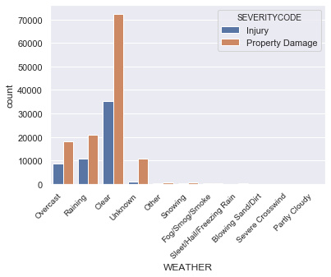
Relationship between weather condition and severity of accident:
Relationship between address type and severity of accident:

Slide 11
3.2 Feature Engineering
I used One Hot encoding for the Categorical variables, like ADDRTYPE, COLLISIONTYPE, WEATHER, ROADCOND, LIGHTCOND
Out of 5 categorial variables I have created 36 new variables, using one hot encoding technique.
All the Integer variables are kept same, they are SEVERITYCODE, PERSONCOUNT, VEHCOUNT, UNDERINFL.
There was only 1 date variable in the dataset which is INCDTTM(incident date and time).
From this variable we created Year, Month, Day, Hours, Minutes, Day of week, Morning or night.
Engineered 7 variables from date variable.
Then I concat all the categorical, integer and date variables into one dataset for machine learning.
Total we have 46 variables and 180067 rows.

Slide 12
3.3 Feature Selection
Feature Variables | Description
ADDRTYPE | Collision address type
COLLISIONTYPE | Collision type
WEATHER | A description of the weather conditions during the time of the collision.
ROADCOND | The condition of the road during the collision.
LIGHTCOND | The light conditions during the collision.
PERSONCOUNT | The total number of people involved in the collision
VEHCOUNT | The number of vehicles involved in the collision.
UNDERINFL | Whether or not a driver involved was under the influence of drugs or alcohol.

Slide 13
3.2Machine Learning Model Selection
The model is trained on the feature attributes of dataset to predict the severity of the accident.
Feature set must be first divided into training set(80%) to train the models and test set(20%) to test the models.
The machine learning models used are Logistic Regression,k-Nearest Neighbor ,SVM and Random forest.

Slide 14
4.Results and Evaluations
 | Logistic | SVM | Random Forest | k-Nearest Neighbors
Accuracy | 75 | 74 | 73 | 69
No. of True Positives | 23764 | 24711 | 22139 | 23670
No. of False Positives | 1256 | 246 | 2881 | 1350
No. of False Negatives | 7736 | 8968 | 6656 | 9674
No. of True Negatives | 3258 | 2089 | 4338 | 1320

Slide 15
5.Discussion
The dataset is analyzed with the help of visualization and modeling of data.
The relationships between the severity code and feature attributes are analysed.
As we can observe the most of the accidents occurred during daytime, on a dry road condition in a clear weather and in block.
The collisions which occurred under influence and over speeding are also very less.

Slide 16
6. Conclusion
I analyzed and visualized the relationship between accident severity (property damage/injury) and under the influence of alcohol, light condition, collision type, road condition, weather condition.
I build classification models to predict whether there is change of having property damage or injury during an accident.
Out of 4 algorithms I used logistic regression gave me 75% accuracy in predicting type of accident sever, based on light condition, collision type, road condition, weather condition.
In future I will use hyper-parameter techniques to increase the accuracy of my model and also create an web app to deploy my model and others to use it for predicting the chance of having accident and how severe it will be.

